Slide 1
Computer Graphics
Presented By : Mr. Madhur Thapliyal
Assistant Professor
School of Computing
GEHU

Slide 2
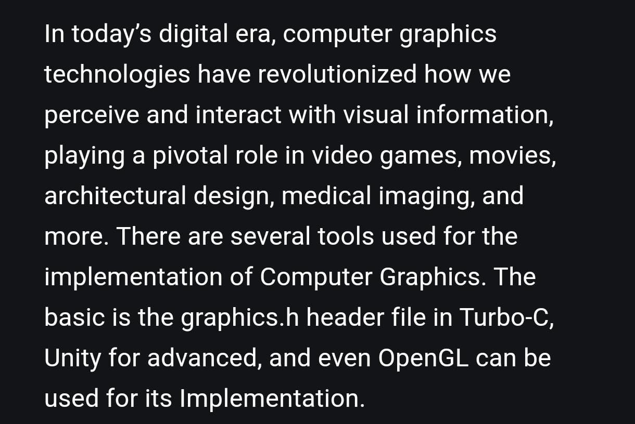
Definition

Slide 3
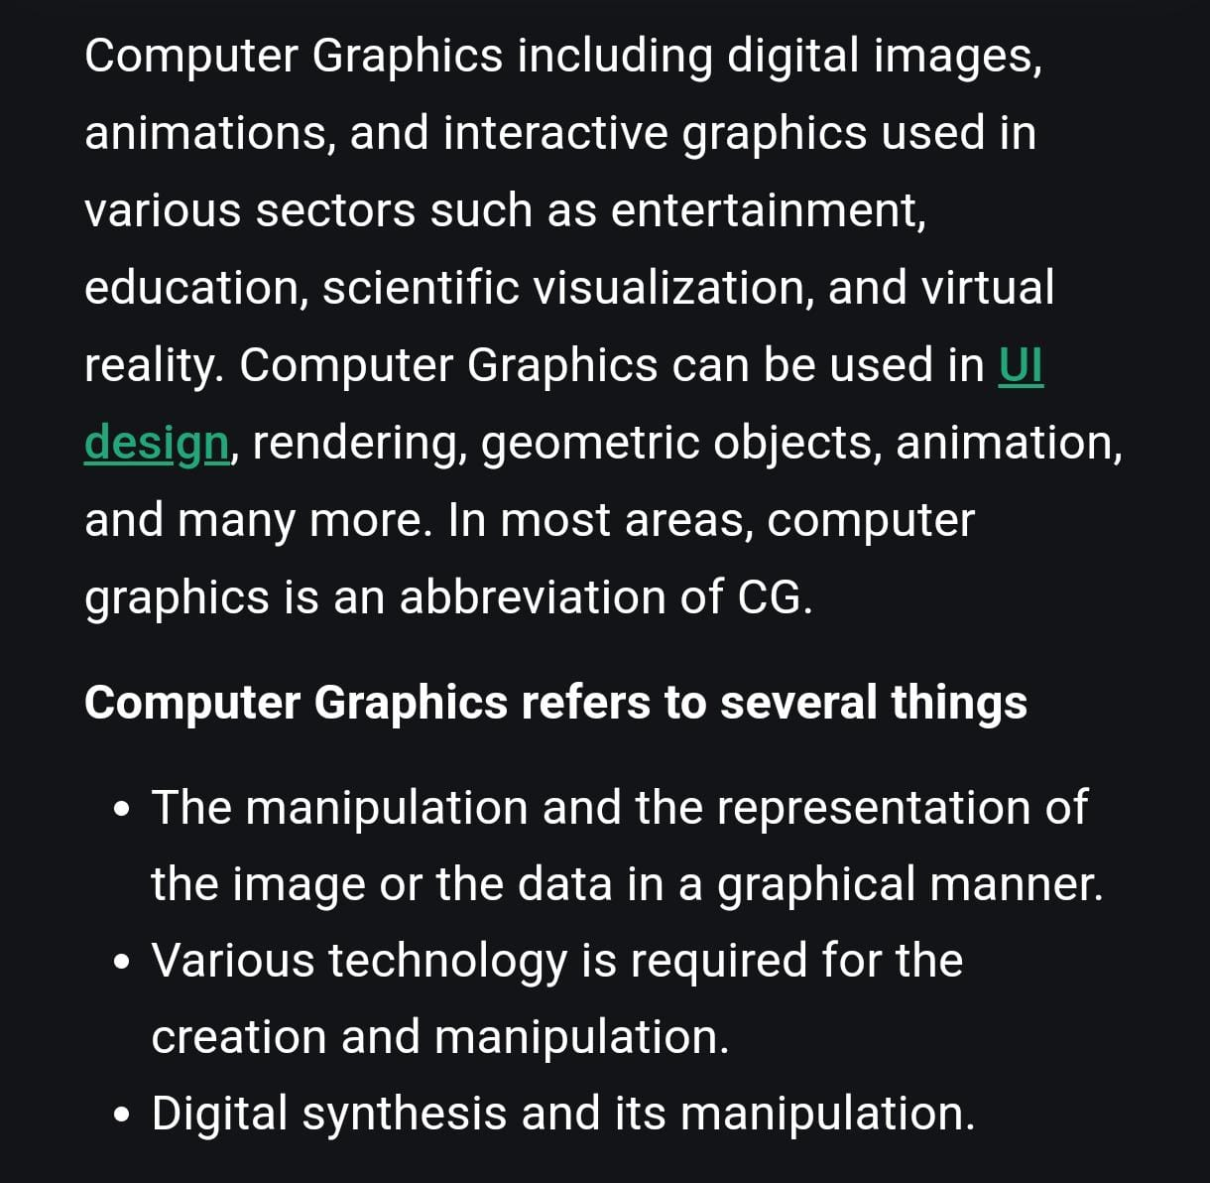

Slide 4
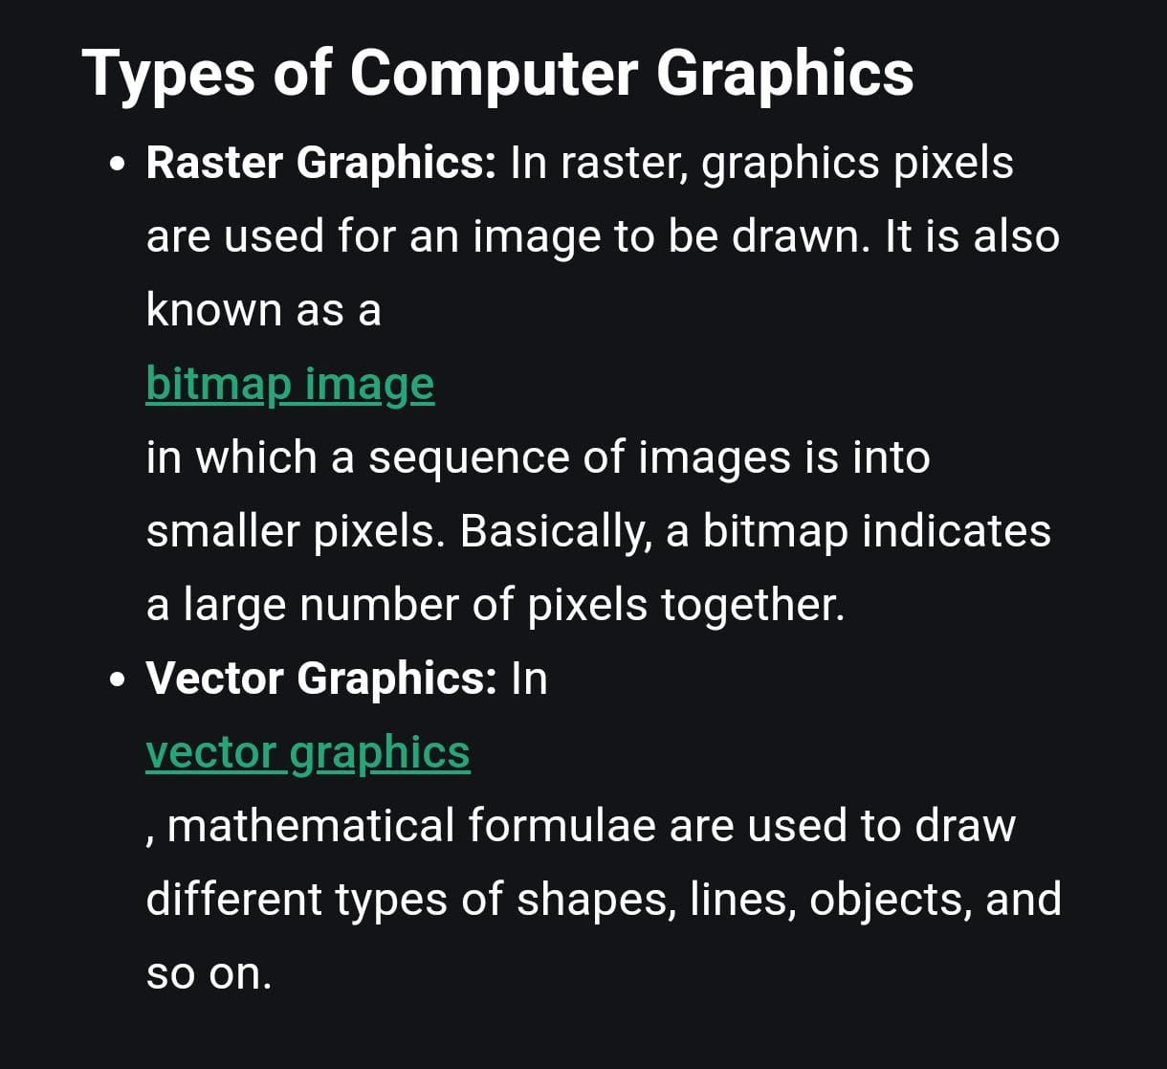

Slide 5
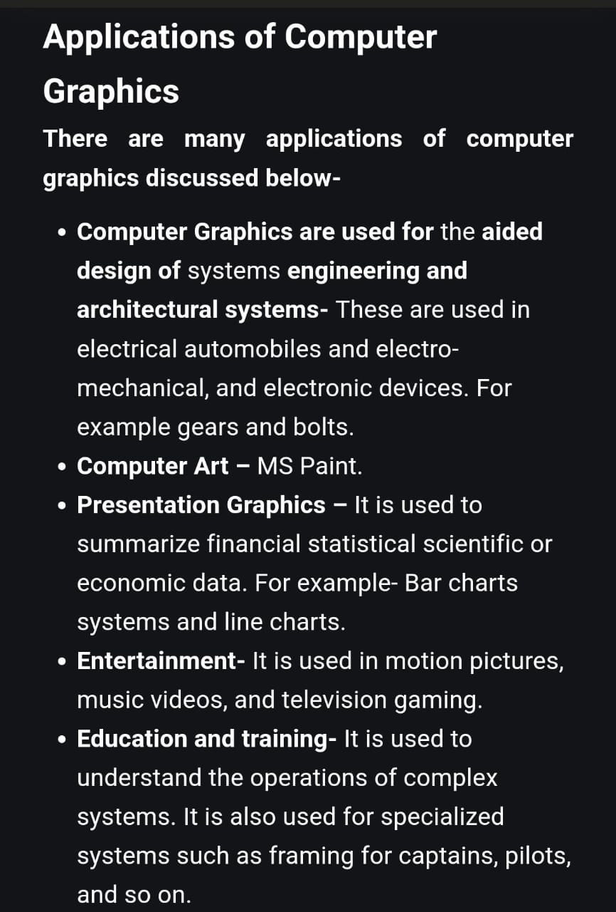

Slide 6
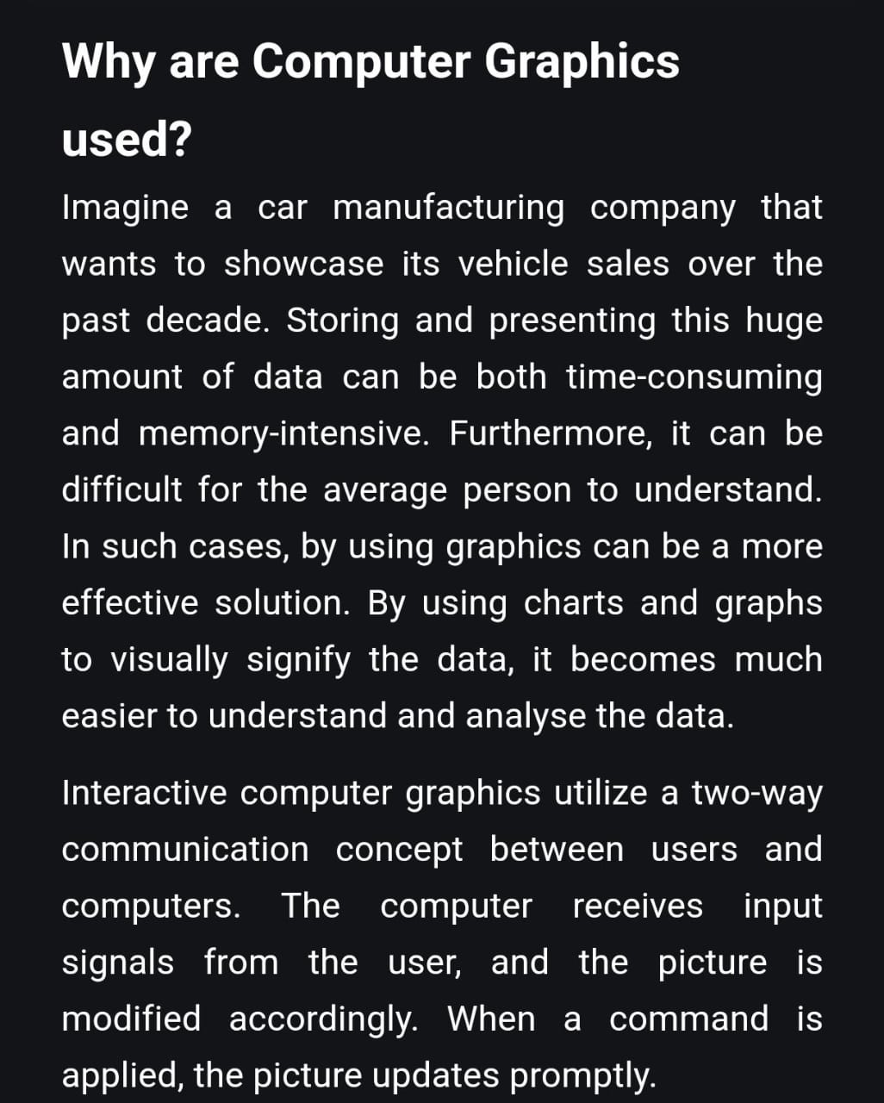
Why Computer Graphics??

